Slide 1
Enemy Tactics, Techniques and Procedures (TTP) In Attacking Convoys

Slide 2
Who is a Target?
BOTTOM LINE – ALL CONVOYS
Focus on easier targets.
Preference for attacking small (2-4 vehicles), lightly-armed convoys.
Convoys with no air security.
Enemy forces tend to attack the rear of convoys, especially convoys with a “weak” rear security element (e.g., no crew served weapon). Hostile forces are actively focusing on vehicles at the rear of convoys to keep the potential attack response to a minimum.
Most attacks take place during hours of darkness; however, there has been a recent increase in the number of attacks during daylight hours.

Slide 3
Types Of Attacks
Small Arms
RPGs
Improvised Explosive Devices (IED)
  Common IEDs such as Timed Explosive Devices and Impact Detonated Devices.
  Command Detonated IEDs which can be detonated by remote control such as cell phone or other electronic means or with wire and a power source.
  Vehicle Borne IEDs (Car Bombs)
Combination Attacks (Most attacks are combination attacks)

Slide 4
Small Arms Ambushes

Slide 5
Typical Small Arms Ambush
Direction of movement
Embankment
OP
Embankment
OP signals convoy approach
Small arms fire is focused on the front windshield, gunner and doors in order to maximize casualties and minimize reaction and return fire
Attack force engages convoy once they are in kill zone

Slide 6
RPG Ambushes

Slide 7
Typical RPG Ambush
Direction of movement
Embankment
OP
OP signals convoy approach
Embankment
Small arms fire is used to divert attention of gunner long enough to get aimed shot with RPG. RPGs fire is focused on head on and broadside shots to maximize accuracy.
Small arms are usually fired
first to draw the attention of
away from the RPG’s.
Attack force engages convoy once they are in kill zone.
Once the small arms opens up the enemy moves into
the road to fire the RPG’s at the vehicles.

Slide 8
IED Ambushes

Slide 9
IED Ingredients
Anything that will explode!
  Artillery Rounds are the preferred explosive (High Explosive or White Phosphorous)
  Any kind of Mine (AT or AP)
  Plastic Explosive such as C4 or Sentex (Much more expensive but also more powerful)
  RDX (Extremely Powerful Powdered Explosive)
  Ammonium Nitrate (Fertilizer) + Diesel fuel + Ryder Truck = Bomb that destroyed OK City Federal Building

Slide 10
Typical IED Ambush
Direction of movement
Embankment
OP
Embankment
Remote Detonated Mines
Wire ran from mines
To a green battery
105 mm ARTY rounds
W/ wire ran into the round.
Rds were 25m apart.
Rds were covered with
Small rocks.

Slide 11
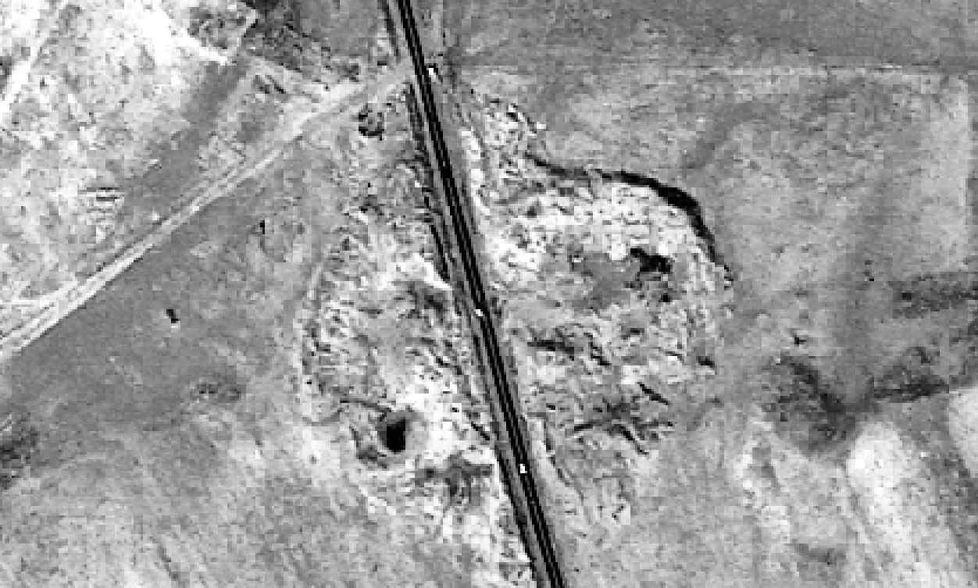

Ambush Site – 21 July 2003
RPG Satchel & Grenade
1. Vehicle Spotted by attackers.
2. Vehicle is struck by RPG Round; round enters just rear of driver’s door, exits right rear tailgate.
3. Vehicle veers to the right, comes to stop facing the east, only two feet from the 1st IED.
1. Vehicle Spotted by attackers
OP with Rock Mound
1. Vehicle Spotted by attackers
1. Vehicle Spotted by attackers
IED; 105mm Round covered by rocks
Both rounds wired back to Battery
Tigris River Road

Slide 12
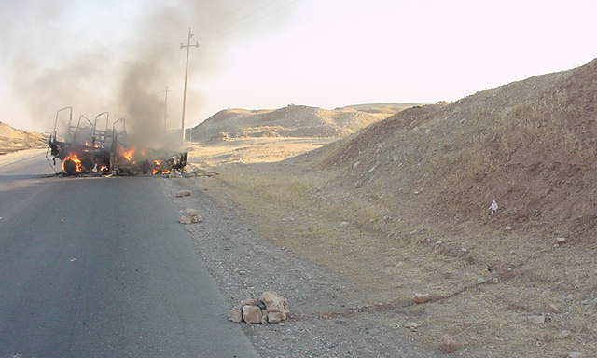
21 May Ambush
Observation Post
2nd IED
1st IED

Slide 13
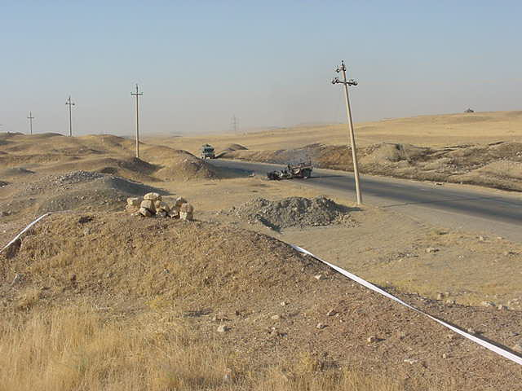
IED Firing Position
(The IEDs were in front of this berm.)
Observation Post
(This was the firing point for the first RPG. 2 more RPGs and grenades found at this location)

Slide 14
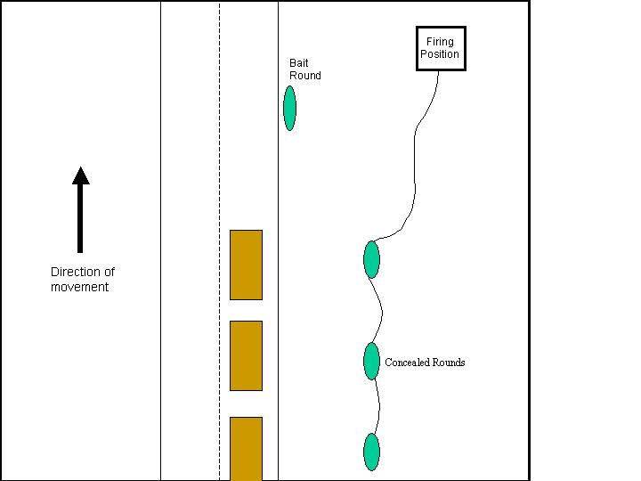
ARTILLERY ROUND IED USED AS BAIT FOR KILL ZONE
A recent technique used by enemy forces is to place a large artillery shell in or near a road as bait. This shell may or may not have wires leading from it. This is designed to get the attention of US forces and to get them to stop short of the readily seen artillery shell. By getting the U.S. vehicles to stop, the convoy is now in a kill zone of several other artillery or mortar shells wired together to explode on command.

Slide 15
Typical Combination Ambush
Broken Down Vehicle or staged injury accident
Vehicle is slowed in the kill zone by a broken down vehicle or staged accident.
Explosives (usually artillery rounds) are buried along the side of the road and may be used in conjunction with mines or small arms fire. Command detonation wire is usually run to concealed location (usually less than 100 meters away)
Small arms or RPGs usually supplement IED Ambush
Kill Zone
OP is used in many cases
Direction of movement
OP

Slide 16
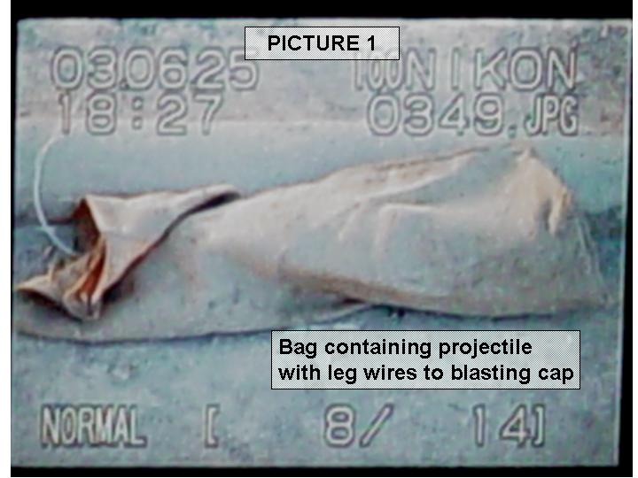
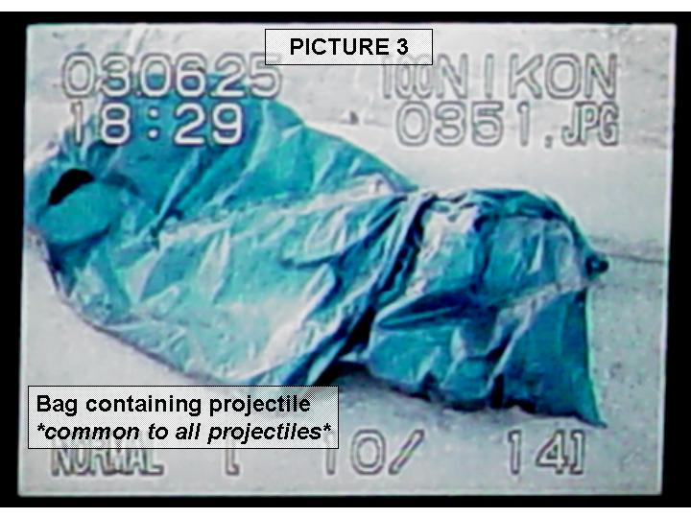
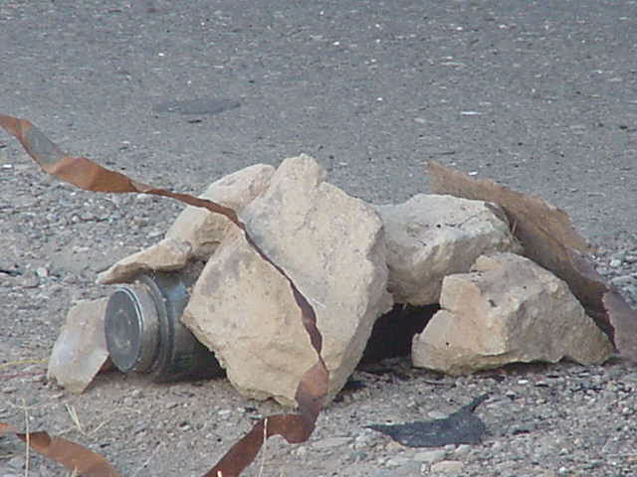
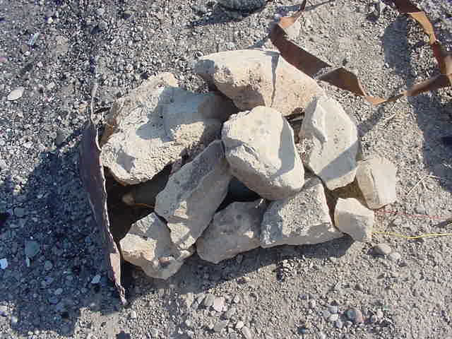
Actual IEDs

Slide 17
IEDs Dropped Into Vehicles
An observer will spot vehicle and signal to partner with IED when to drop. Uncovered and soft topped vehicles are primary targets. Most IEDs are either impact detonated or timed.
Person with IED
Overpass
OP
Observer
Direction of movement

Slide 18
Protective Measures

Slide 19
Small Arms/RPG’s Attacks
MAKE YOURSELF AS SMALL OF A TARGET AS POSSIBLE!!
Speed up through the kill zone. Once out of the kill zone maneuver and kill the enemy.
Return fire with overwhelming fire.
Have a rear security element with a vehicle mounted crew served weapon 200 to 300 meters behind main convoy.
Build up as much protection on vehicle as possible (ie. Sandbags)
Smaller vehicles can use evasive maneuvers (RPGs fly relatively slow)
BODY ARMOR!

Slide 20
IED Attacks
Remain alert (Watch for potential IEDs)
  If it looks out of place IT PROBABLY IS!
  Watch for the absence of children where there normally are many.
Do not stop for broken down vehicles or accidents.
Do not slow or stop for suspected UXO.
Be cautious when approaching overpasses or embankments.
Doors off in order to react to threat and for greater fields of fire.

Slide 21
ALL Attacks
Reconnaissance
  Be alert for people observing you. If personnel appear to be counting the number of vehicles in your convoy, or seem overly interested in your convoy, stay alert (especially if on cell phone)! These personnel may be a scout or recon asset for a potential ambush force farther down the road, and may call/signal your approach to this ambush force.
Other signaling measures, particularly in urban areas.
  Watch for lights in an area going off or horns honking. This could be a signal for ambush force near by. Other signaling methods are unaimed gunfire.
  Be wary of people on cell phones that are watching your vehicles. Thuraya phones are the Commo of choice.
  Recognizing the signals can help you anticipate attack and avoid the engagement all together.

Slide 22
ALL Attacks (cont.)
Use of children, adolescents or women
  There have been cases in which children, teenagers have been used as both recon and attack assets.
Attacks from access roads, buildings, overpasses or thick brush along MSR/ASRs.
  These are used because they provide cover and concealment as well as an avenue for escape.

Slide 23
Convoy Protective Measures
Take quickest lane, the one in the best shape to allow for quick travel.
If road quality is equal, travel down middle of road.
Allow Convoy Commander to vary convoy position (left, right, middle lane), rate of speed, SP times, and, if feasible, routes. Allow unpredictability.
Ensure radios are filled and working, and crews have NVGs (driver, TC, and gunner).
Ensure vehicles that are not in the kill zone lay down maximum volume of fire to destroy the enemy.
All drivers and TC’s need to be alert at all times and looking for signs of ambushes or observers.
Ensure that your loads are properly secured. Loads that shift or fall off of the truck create hazards and could possible force the vehicles to stop creating an easy target

Slide 24
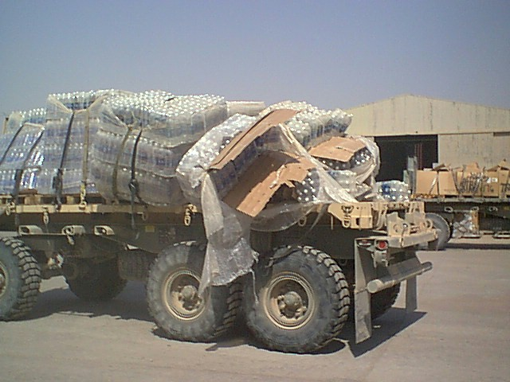
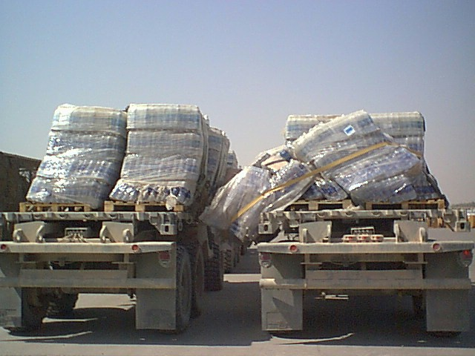
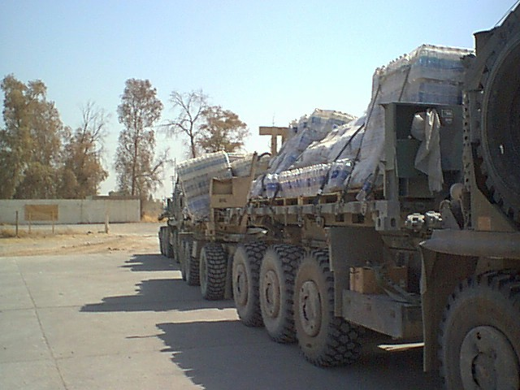
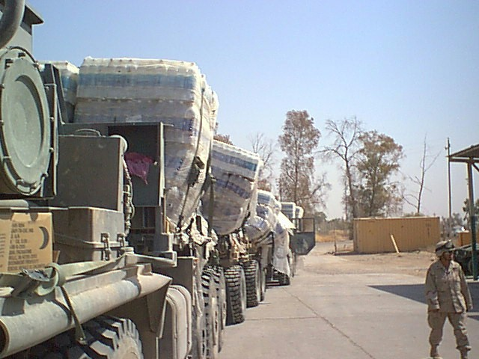
01 SEP 03 501st SSA

Slide 25
Gun Truck Tactics and Design Ideas

Slide 26
Gun Truck TTPs
At least 1 Gun Truck per 9 vehicles.
Best location for Single Gun Truck is rear of convoy in order to react to hostilities forward in convoy.
When using two Gun Trucks, optimal use is one Gun Truck scouts ahead of the convoy and one gun truck remains 300 meters behind the convoy.

Slide 27
Gun Truck TTPs
In crowded areas, Gun Trucks can be used to disperse crowds, and to block off intersections to allow convoys through.
Gun Trucks must over watch each other when confronted with possible enemy action. Place as many Gun Trucks per convoy as possible in show of force to act as deterrent.
Non-Gun Trucks vehicles must also show force with weapons displayed.

Slide 28
Gun Truck Design Ideas
All vehicles should use sandbags in the floors and under seats or any other method to increase protection for occupants
Built up guard platform (SAW, M203, AT4).
For vehicles that have them, open the roof of every truck and put a guard with SAW in the hole.

Slide 29
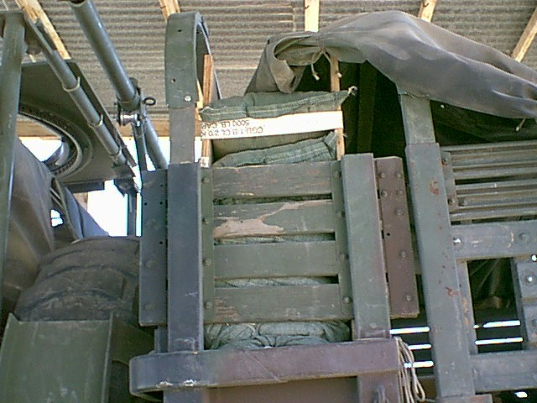
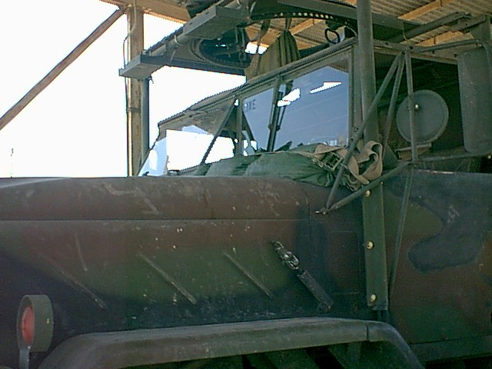
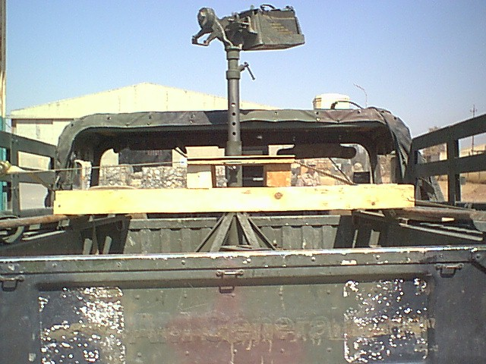
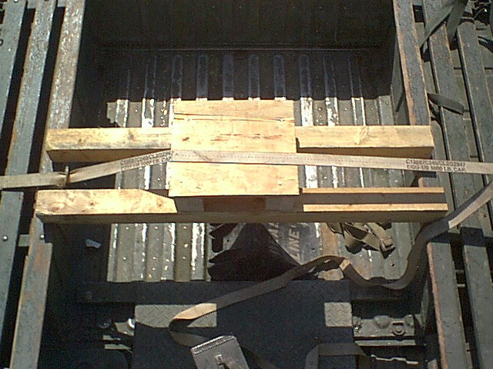

Slide 30
Gun Truck Requirements
Must protect gunner(s) from IEDs, direct fire, and movement of the vehicle itself
Must stabilize weapon system
Cannot be top heavy
Must give 200 degree+ area of visibility and firing (All turrets must be in good working order.)

